Slide 1
Northern Chamber Orchestra Side-by-Side Projects 2023/24

Slide 2
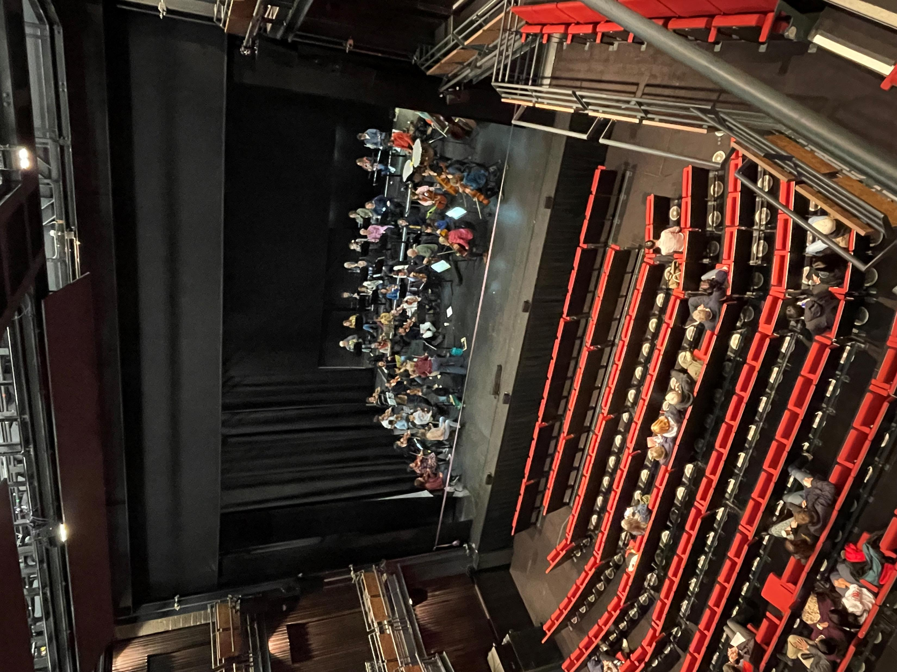
Edsential/NCO Side-by-Side Projects 2023/24
Edsential Musical Routes have engaged with the Northern Chamber Orchestra to deliver 4 side-by-side projects throughout 2023/24.
The aim is to give our young musicians the chance to play alongside a professional orchestra at a prestigious venue.
Each project is aimed at a different set of musicians, catering for beginner to the more advanced students.
The projects all take place on a Sunday afternoon at the Story House, Chester and are part of the NCO’s regular concert series.
Additional funding from Arts Council England has been awarded to NCO to support the projects.
Alongside a rehearsal with the NCO, the students also have rehearsal time with Edsential tutors, and are invited alongside their families to watch NCO perform their concert in the venue for free.

Slide 3
Project 1 – Sunday 15th October
Intermediate to advanced string players were invited to take part in the first project.
Repertoire – Haydn Symphony 104
Invitations were sent to all intermediate to advanced string players who were either in an Edsential ensemble or having lessons with an Edsential tutor.
Invitations were also sent to all secondary schools within the area.
15 Students attended the project.

Slide 4
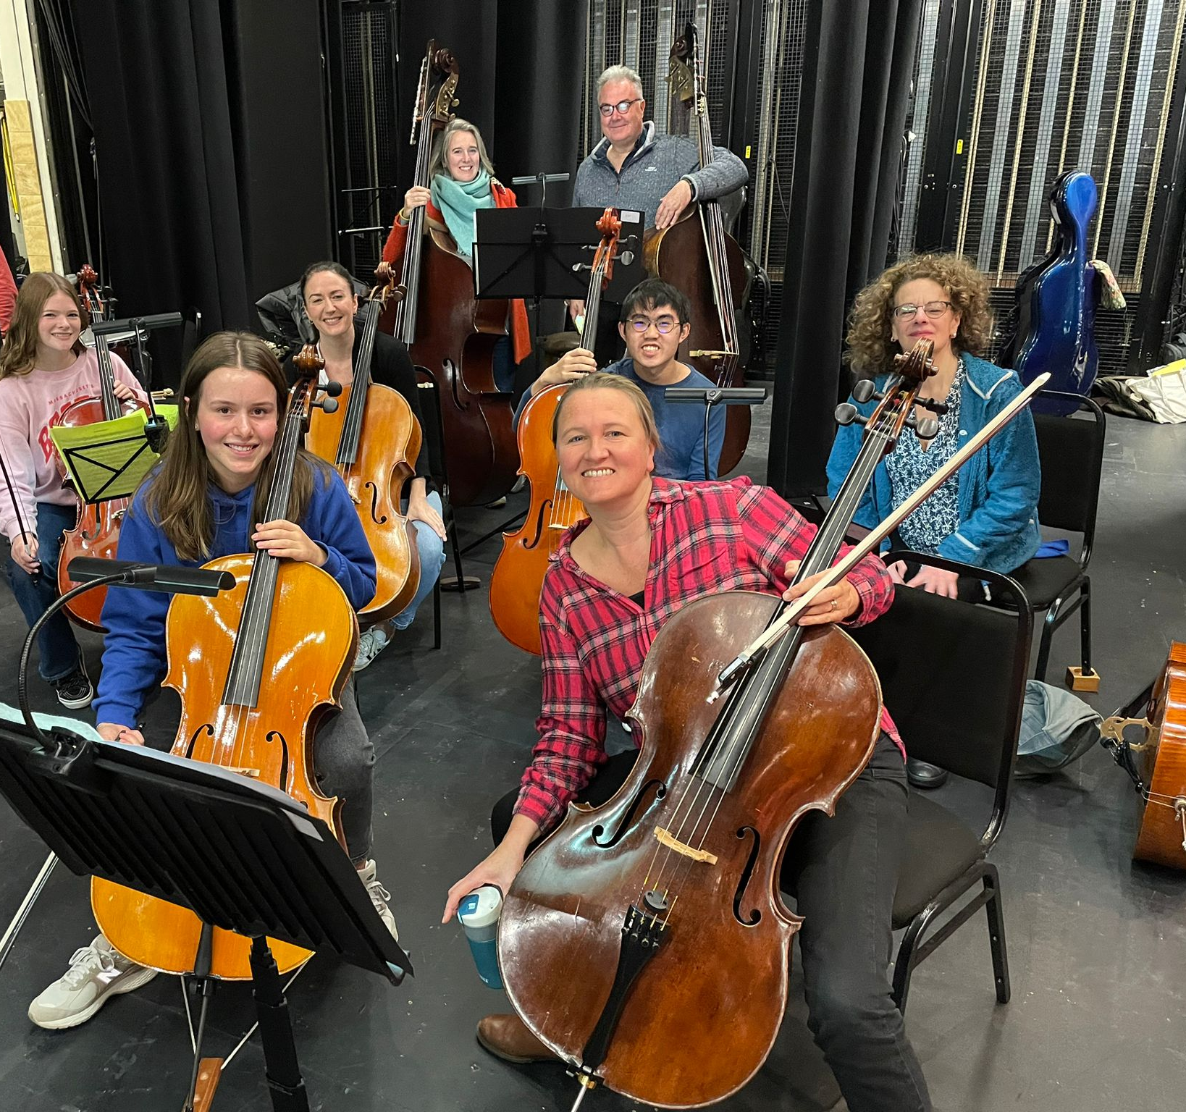
Timetable
12.00pm – Students arrive at the Story House
12.30pm – 1.30pm – Rehearsal with Edsential Tutors
1.45pm – 2.30pm – Rehearsal on Stage with NCO
2.30pm – Students dismissed to their parents
3.30pm – Students and their families invited to watch NCO concert

Slide 5
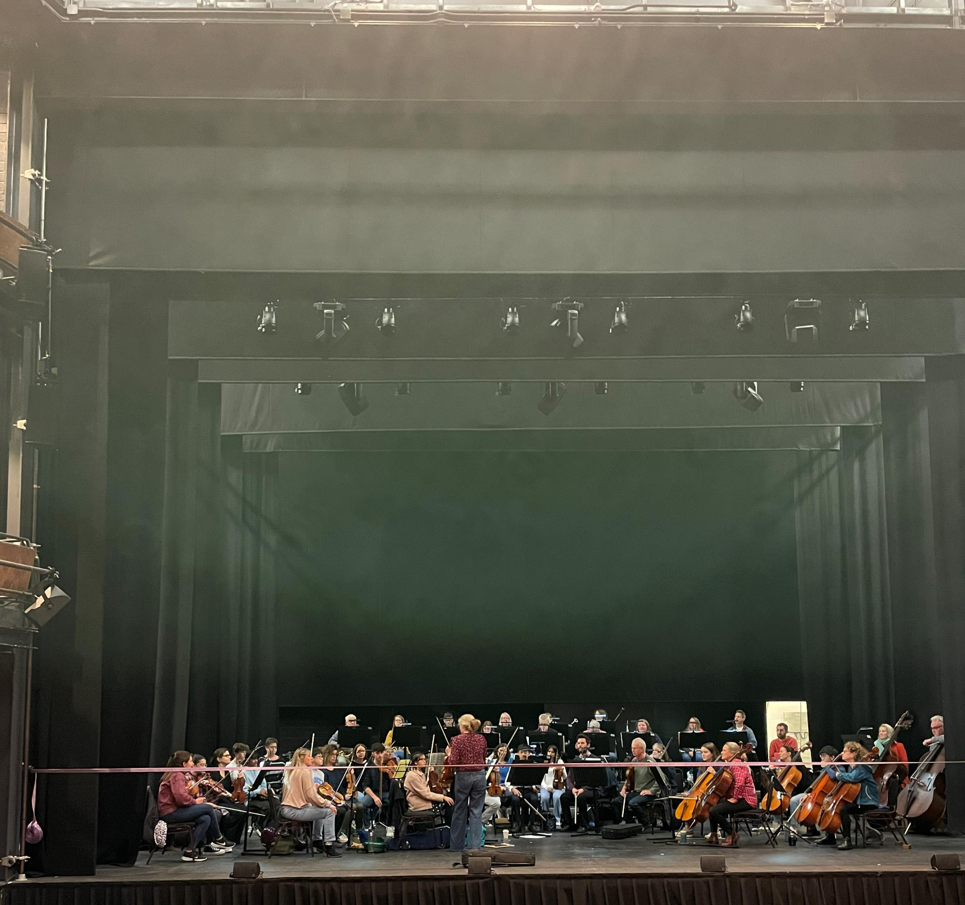
Student Feedback
A questionnaire was sent to all 15 students taking part in the event.
9 students in total responded.
The feedback was overall very positive.

Slide 6
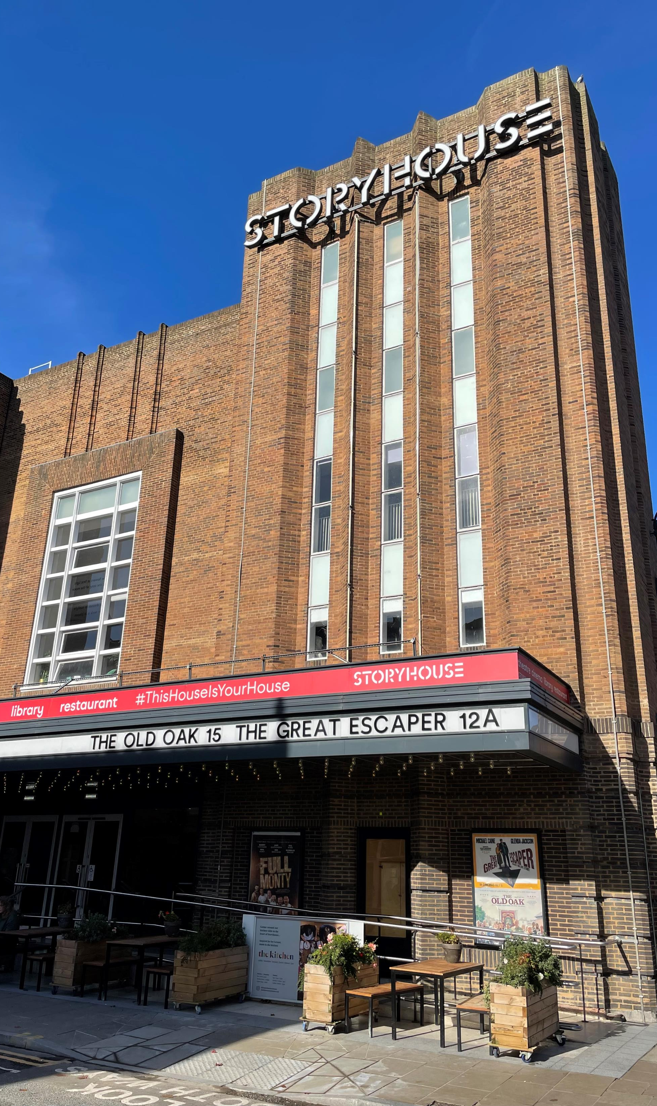
Did you enjoy playing the Haydn Symphony? – 4.4 out of 5
How helpful did you find the Edsential tutors? – 4.8 out of 5
Did you enjoy the rehearsal with the Edsential tutors? 4.3 out of 5
Did you find this useful? 4.3 out of 5
Did you enjoy the rehearsal with the Northern Chamber Orchestra? 4.8 out of 5
Did you feel supported by the members of the Northern Chamber Orchestra? 4.4 out of 5
Did your confidence levels increase during the day? 3.9 out of 5

Slide 7
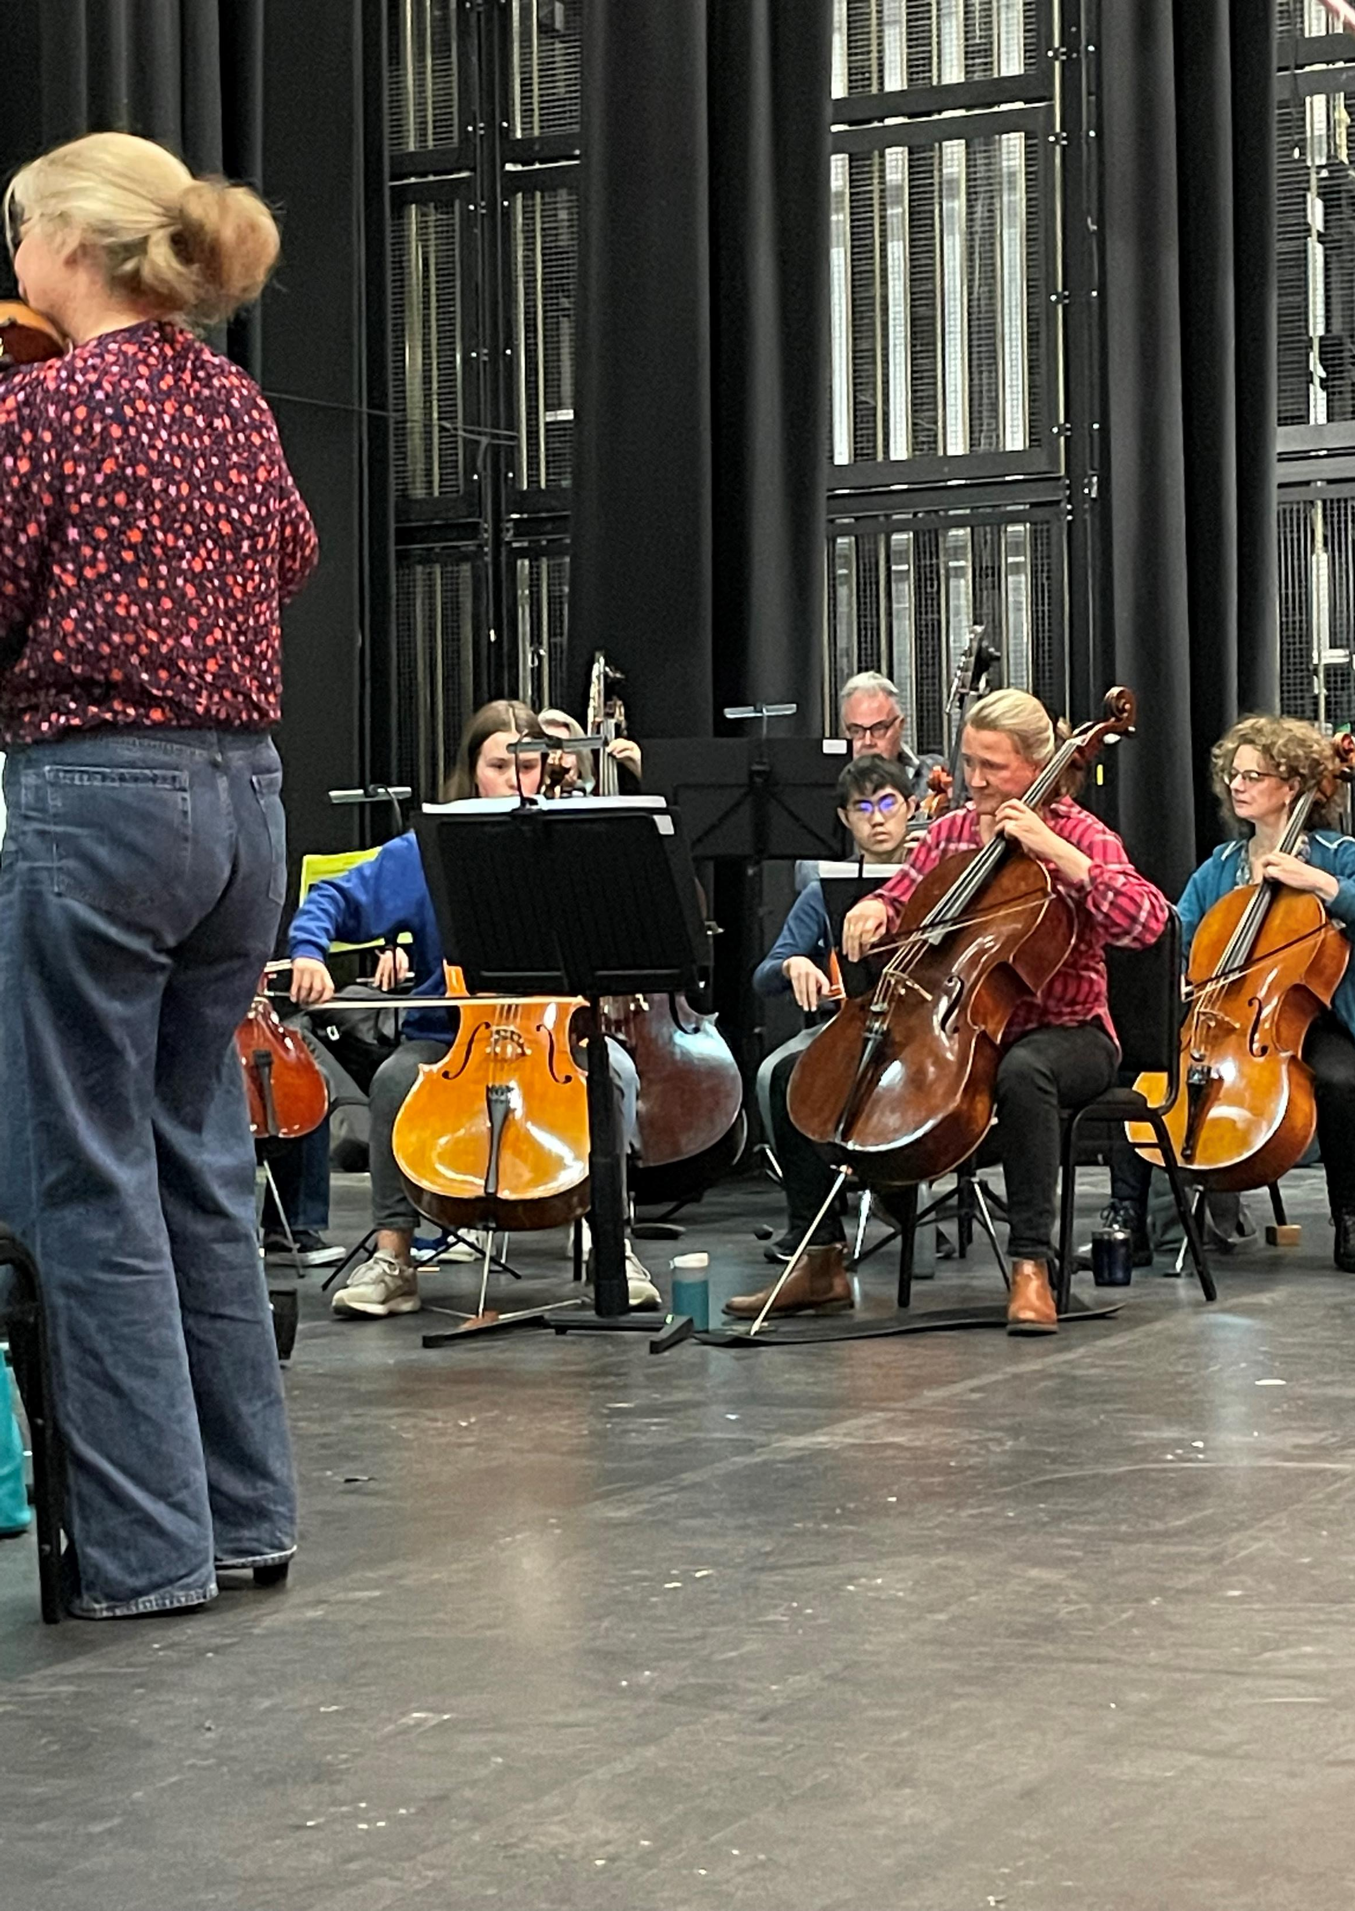
Did you stay to watch the concert?
6 – Yes, 3 – No
What did you like about the concert?
‘I liked the varied Programme’
‘The Piano Playing’
‘Everything!’
‘Watching everyone working Together’
‘I liked how fast they played the 4th Movement’
‘Lovely seeing a real orchestra, they sounded amazing’

Slide 8
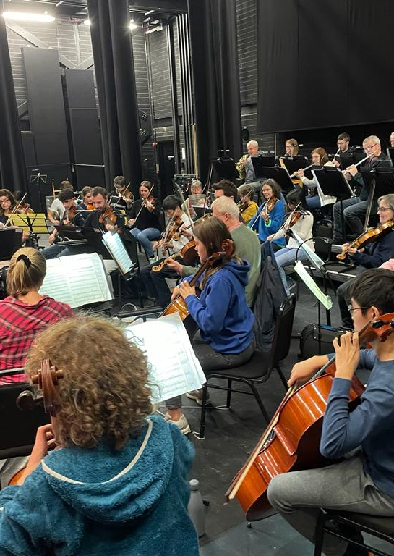
What did you learn through taking part in the project?
‘I have learnt and felt the formal performance’
‘Dynamics’
‘I have learnt to exaggerate the dynamics’
‘Techniques
‘String Techniques’
‘How to make use of the bow to control volume’
‘Bowing Skills’
‘How a professional orchestra works’
‘That it is nice to work with people you don't really know because we speak the same language of music’

Slide 9
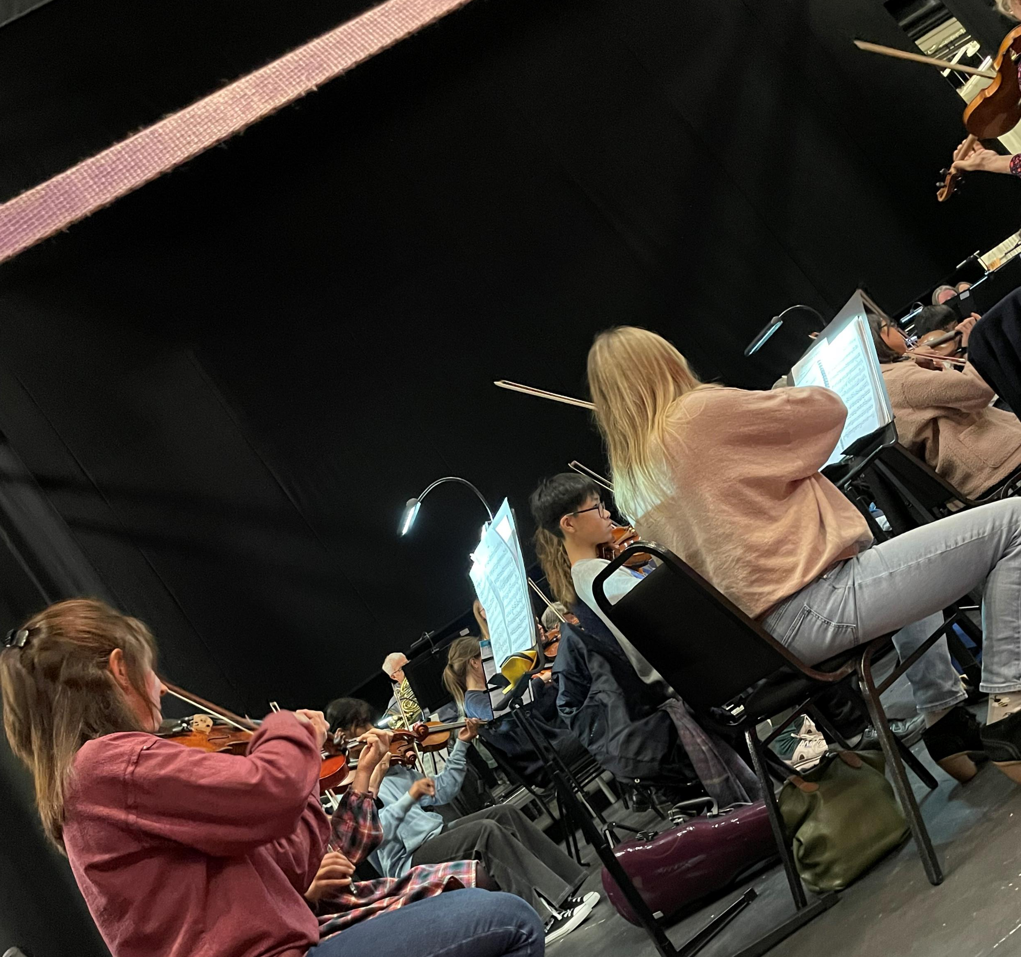
Would you be interested in taking part in similar events?
9 answered yes
Would you recommend a similar event to your friends?
9 answered yes

Slide 10
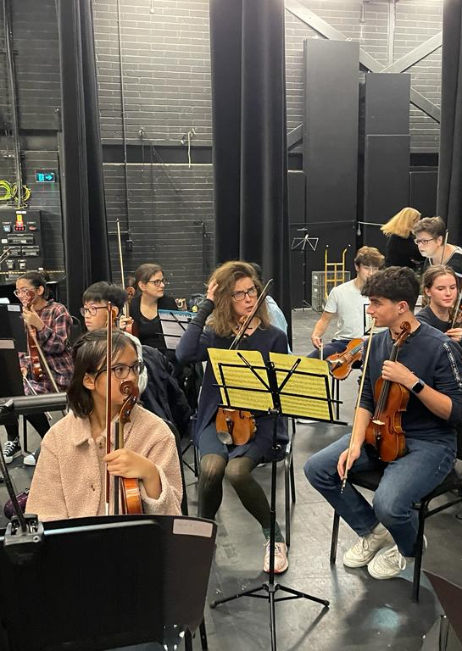
Please can you tell me something that you really enjoyed about the experience?
‘Playing with the professional orchestra’
‘Spending time with the orchestra especially talking to and learning from the cello players’
‘I enjoyed playing with a professional orchestra’
‘Playing with the orchestra at the end of the rehearsal and being part of the professionals’
‘The performance’
‘Playing in the orchestra’
‘Being able to play in a full orchestra’
‘Being with the orchestra and performing on stage’
‘Playing with a mixture of friends and professionals’

Slide 11
Finally, is there anything further you would like to say about the event?
It was an amazing experience!
It was amazing and I would do it all over again!
Thank you, I learnt so much!
It was amazing, thank you so much!
Thank you for a great day!

Slide 12
Project 2 – Sunday 21st January
For intermediate to advanced Woodwind and French Horn players.
Repertoire – Strauss Serenade for Winds.
Invitations have gone to all ensemble members and to all school contacts.
6 Pupils already signed up to the project, with a target of 10.
Project 3 – Sunday 10th March 2024
Project 4 – Sunday 2nd June 2024

Slide 13
Links….
Young Edsential musicians play alongside Northern Chamber Orchestra – Edsential
28.06.23 | Northern Chamber Orchestra embark on new venture in Chester and Port Sunlight - Northern Chamber Orchestra (ncorch.co.uk)

